Slide 1
How to write a great research paper
Simon Peyton Jones
Microsoft Research, Cambridge

Slide 2
Writing papers is a skill
Many papers are badly written
Good writing is a skill you can learn
It’s a skill that is worth learning:
You will get more brownie points (more papers accepted etc)
Your ideas will have more impact
You will have better ideas
Increasing importance

Slide 3
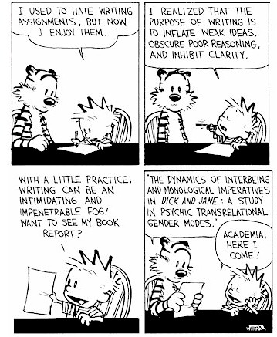
Why write papers?
Good papers and talks are a fundamental part of research excellence
To impress others, gain recognition, and get promoted
No

Slide 4
Why write papers?
No
To describe what you have done
Your reader does not care about you

Slide 5
Why write papers?
To describe the WizWoz system
No
Your reader does not have a WizWoz

Slide 6
Why write papers?
To describe something new
But in design, in contrast with science, novelty in itself has no merit.
If we recognize our artifacts as tools, we test them by their usefulness and their costs, not their novelty.
Fred Brooks “The Computer Scientist as Toolsmith”, Comm ACM 39(5), March 1996
No

Slide 7
Why write papers?
Yes
To convey a useful and re-usable idea
If we perceive our role aright, we then see more clearly the proper criterion for success: a toolmaker succeeds as, and only as, the users of his tool succeed with his aid. However shining the blade, however jewelled the hilt, however perfect the heft, a sword is tested only by cutting. That swordsmith is successful whose clients die of old age.
Fred Brooks “The Computer Scientist as Toolsmith”

Slide 8
Papers communicate ideas
Your goal: to infect the mind of your reader with your idea, like a virus
Papers are far more durable than programs (think Mozart)
The greatest ideas are (literally) worthless if you keep them to yourself

Slide 9
Writing papers: model 1
Idea
Do research
Write paper

Slide 10
Writing papers: model 2
Idea
Do research
Write paper
Idea
Write paper
Do research
Forces us to be clear, focused
Crystallises what we don’t understand
Opens the way to dialogue with others: reality check, critique, and collaboration

Slide 11
Do not be intimidated
Fallacy You need to have a fantastic idea before you can write a paper. (Everyone else seems to.)
Write a paper, and give a talk, about any idea, no matter how weedy and insignificant it may seem to you

Slide 12
Do not be intimidated
Write a paper, and give a talk, about any idea, no matter how insignificant it may seem to you
Writing the paper is how you develop the idea in the first place
It usually turns out to be more interesting and challenging that it seemed at first

Slide 13
The Idea
Idea
A re-usable insight,
useful to the reader
Your paper should have just one “ping”: one clear, sharp idea
You may not know exactly what the ping is when you start writing; but you must know when you finish
If you have lots of ideas, write lots of papers

Slide 14
Can you hear the “ping”?
Many papers contain good ideas, but do not distil what they are.
Make certain that the reader is in no doubt what the idea is. Be 100% explicit:
“The main idea of this paper is....”
“In this section we present the main contributions of the paper.”
Thanks to Joe Touch for “one ping”

Slide 15
Your narrative flow
I wish I knew how to solve that!
Here is a problem
It’s an interesting problem
It’s an unsolved problem
Here is my idea
My idea works (details, data)
Here’s how my idea compares to other people’s approaches
I see how that works. Ingenious!

Slide 16
Structure (conference paper)
Title (1000 readers)
Abstract (4 sentences, 100 readers)
Introduction (1 page, 100 readers)
The problem (1 page, 10 readers)
My idea (2 pages, 10 readers)
The details (5 pages, 3 readers)
Related work (1-2 pages, 10 readers)
Conclusions and further work (0.5 pages)

Slide 17
The abstract
I usually write the abstract last
Used by program committee members to decide which papers to read
Four sentences [Kent Beck]
State the problem
Say why it’s an interesting problem
Say what your solution achieves
Say what follows from your solution

Slide 18
Example
Many papers are badly written and hard to understand
This is a pity, because their good ideas may go unappreciated
Following simple guidelines can dramatically improve the quality of your papers
Your work will be used more, and the feedback you get from others will in turn improve your research

Slide 19
Structure
Abstract (4 sentences)
Introduction (1 page)
The problem (1 page)
My idea (2 pages)
The details (5 pages)
Related work (1-2 pages)
Conclusions and further work (0.5 pages)

Slide 20
The introduction (1 page)
Describe the problem
State your contributions
...and that is all
ONE PAGE!

Slide 21
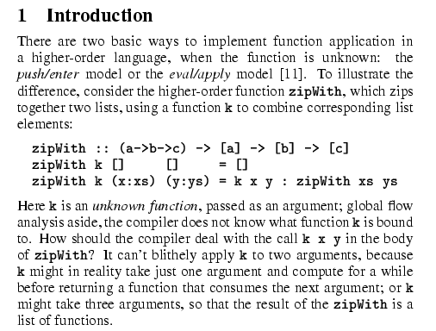
Describe the problem
Use an example to introduce the problem

Slide 22
Molehills not mountains
“Computer programs often have bugs. It is very important to eliminate these bugs [1,2]. Many researchers have tried [3,4,5,6]. It really is very important.”
“Consider this program, which has an interesting bug. <brief description>. We will show an automatic technique for identifying and removing such bugs”
Yawn
Cool!

Slide 23
State your contributions
Write the list of contributions first
The list of contributions drives the entire paper: the paper substantiates the claims you have made
Reader thinks “gosh, if they can really deliver this, that’s be exciting; I’d better read on”

Slide 24
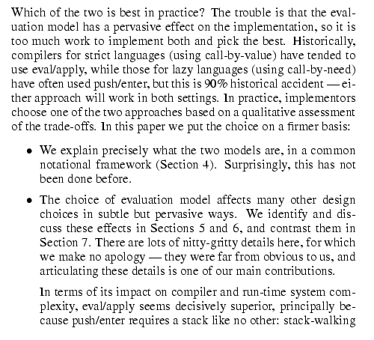
State your contributions
Bulleted list of contributions
Do not leave the reader to guess what your contributions are!

Slide 25
Contributions should be refutable
NO! | YES!
We describe the WizWoz system. It is really cool. | We give the syntax and semantics of a language that supports concurrent processes (Section 3). Its innovative features are...
We study its properties | We prove that the type system is sound, and that type checking is decidable (Section 4)
We have used WizWoz in practice | We have built a GUI toolkit in WizWoz, and used it to implement a text editor (Section 5). The result is half the length of the Java version.

Slide 26
No “rest of this paper is...”
Not:
Instead, use forward references from the narrative in the introduction. The introduction (including the contributions) should survey the whole paper, and therefore forward reference every important part.
“The rest of this paper is structured as follows. Section 2 introduces the problem. Section 3 ... Finally, Section 8 concludes”.

Slide 27
Structure
Abstract (4 sentences)
Introduction (1 page)
Related work
The problem (1 page)
My idea (2 pages)
The details (5 pages)
Related work (1-2 pages)
Conclusions and further work (0.5 pages)

Slide 28
No related work yet!
Related work
Your reader
Your idea
We adopt the notion of transaction from Brown [1], as modified for distributed systems by White [2], using the four-phase interpolation algorithm of Green [3]. Our work differs from White in our advanced revocation protocol, which deals with the case of priority inversion as described by Yellow [4].

Slide 29
No related work yet
I feel stupid
Problem 1: the reader knows nothing about the problem yet; so your (carefully trimmed) description of various technical tradeoffs is absolutely incomprehensible
Problem 2: describing alternative approaches gets between the reader and your idea
I feel tired

Slide 30
Structure
Abstract (4 sentences)
Introduction (1 page)
The problem (1 page)
My idea (2 pages)
The details (5 pages)
Related work (1-2 pages)
Conclusions and further work (0.5 pages)

Slide 31
Presenting the idea
3. The idea
Consider a bifircuated semi-lattice D, over a hyper-modulated signature S. Suppose p_{i} is an element of D. Then we know for every such p_{i} there is an epi-modulus j, such that p_{j} < p_{i}.
Sounds impressive...but
Sends readers to sleep
In a paper you MUST provide the details, but FIRST convey the idea

Slide 32
Presenting the idea
Explain it as if you were speaking to someone using a whiteboard
Conveying the intuition is primary, not secondary
Once your reader has the intuition, she can follow the details (but not vice versa)
Even if she skips the details, she still takes away something valuable

Slide 33
Putting the reader first
Do not recapitulate your personal journey of discovery. This route may be soaked with your blood, but that is not interesting to the reader.
Instead, choose the most direct route to the idea.

Slide 34
The payload of your paper
Introduce the problem, and your idea, using
EXAMPLES
and only then present the general case

Slide 35
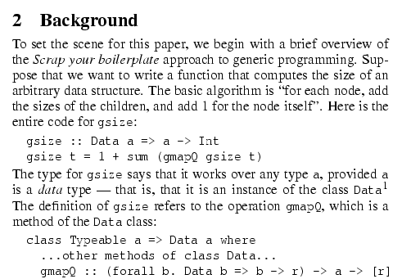
Using examples
The Simon PJ question: is there any typewriter font?
Example right away

Slide 36
The details: evidence
Your introduction makes claims
The body of the paper provides evidence to support each claim
Check each claim in the introduction, identify the evidence, and forward-reference it from the claim
Evidence can be: analysis and comparison, theorems, measurements, case studies

Slide 37
Structure
Abstract (4 sentences)
Introduction (1 page)
The problem (1 page)
My idea (2 pages)
The details (5 pages)
Related work (1-2 pages)
Conclusions and further work (0.5 pages)

Slide 38
Related work
Fallacy To make my work look good, I have to make other people’s work look bad

Slide 39
The truth: credit is not like money
Giving credit to others does not diminish the credit you get from your paper
Warmly acknowledge people who have helped you
Be generous to the competition. “In his inspiring paper [Foo98] Foogle shows.... We develop his foundation in the following ways...”
Acknowledge weaknesses in your approach

Slide 40
Credit is not like money
Failing to give credit to others can kill your paper
If you imply that an idea is yours, and the referee knows it is not, then either
You don’t know that it’s an old idea (bad)
You do know, but are pretending it’s yours (very bad)

Slide 41
Structure
Abstract (4 sentences)
Introduction (1 page)
The problem (1 page)
My idea (2 pages)
The details (5 pages)
Related work (1-2 pages)
Conclusions and further work (0.5 pages)

Slide 42
Conclusions and further work
Be brief.
For future work, say what you intend to do. Don’t waste space on ambitious but unattractive developments.

Slide 43
The process of writing

Slide 44
The process
Start early. Very early.
Hastily-written papers get rejected.
Papers are like wine: they need time to mature
Collaborate
Use CVS to support collaboration

Slide 45
Getting help
Get your paper read by as many friendly guinea pigs as possible
Experts are good
Non-experts are also very good
Each reader can only read your paper for the first time once! So use them carefully
Explain carefully what you want (“I got lost here” is much more important than “Jarva is mis-spelt”.)

Slide 46
Getting expert help
A good plan: when you think you are done, send the draft to the competition saying “could you help me ensure that I describe your work fairly?”.
Often they will respond with helpful critique (they are interested in the area)
They are likely to be your referees anyway, so getting their comments or criticism up front is Jolly Good.

Slide 47
Listening to your reviewers
Treat every review like gold dust
Be (truly) grateful for criticism as well as praise
This is really, really, really hard
But it’s really, really, really, really, really, really, really, really, really, really important

Slide 48
Listening to your reviewers
Read every criticism as a positive suggestion for something you could explain more clearly
DO NOT respond “you stupid person, I meant X”. Fix the paper so that X is apparent even to the stupidest reader.
Thank them warmly. They have given up their time for you.

Slide 49
Language and style

Slide 50
Basic stuff
Submit by the deadline
Keep to the length restrictions
Do not narrow the margins
Do not use 6pt font
On occasion, supply supporting evidence (e.g. experimental data, or a written-out proof) in an appendix
Always use a spell checker

Slide 51
Visual structure
Give strong visual structure to your paper using
sections and sub-sections
bullets
italics
laid-out code
Find out how to draw pictures, and use them

Slide 52
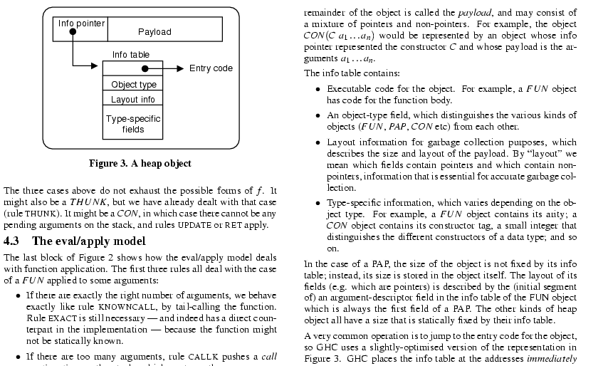
Visual structure

Slide 53
Use the active voice
The passive voice is “respectable” but it DEADENS your paper. Avoid it at all costs.
“We” = you and the reader
NO | YES
It can be seen that... | We can see that...
34 tests were run | We ran 34 tests
These properties were thought desirable | We wanted to retain these properties
It might be thought that this would be a type error | You might think this would be a type error
“We” = the authors
“You” = the reader

Slide 54
Use simple, direct language
NO | YES
The object under study was displaced horizontally | The ball moved sideways
On an annual basis | Yearly
Endeavour to ascertain | Find out
It could be considered that the speed of storage reclamation left something to be desired | The garbage collector was really slow

Slide 55
Summary
If you remember nothing else:
Identify your key idea
Make your contributions explicit
Use examples
A good starting point:
“Advice on Research and Writing”
http://www-2.cs.cmu.edu/afs/cs.cmu.edu/user/ mleone/web/how-to.html

